Slide 1
From API Calls to Analysis‑Ready Zarr: Leveraging NASA POWER on AWS for Scalable Agro‑Weather Services
Dr. Pavan Willingthon, Assistant Professor
University of Florida
Florida, USA
POWER tools used: AWS S3 Zarr (primary), POWER API (validation), Data Access Viewer (QA)
Data courtesy of NASA POWER (https://power.larc.nasa.gov)

Slide 2
Introduction
Purpose: End‑to‑end agro‑weather service powered by NASA POWER
What: CHIRPS precipitation + NASA POWER meteorology for time series, stats, and ICASA weather files
Who: Serves agronomists, researchers, and local farmers via a web app and an API
Backbone: NASA POWER MERRA‑2 (T2M, TMAX, TMIN, TDEW, RH2M, WS2M, PRECTOTCORR) and solar (SRB/SYN1deg/FLASHFlux) in Zarr on AWS
Data courtesy of NASA POWER (https://power.larc.nasa.gov)

Slide 3
The Problem (How We Work With POWER)
Decision focus: Rapid, reliable weather inputs for modeling and DSSAT ICASA files at scale
Bottleneck solved: API‑first prototypes hit request overhead and rate limits for batch workflows
Why POWER: Consistent, temporal‑first Zarr stores on AWS remove per‑request overhead and align with daily slicing
Workflow fit: Date‑range cache warming + bounded local Zarr subsets enable multi‑point, multi‑year exports
Data courtesy of NASA POWER (https://power.larc.nasa.gov)

Slide 4
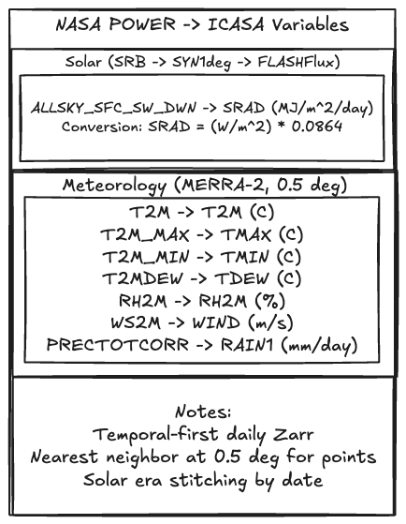
POWER Usage (Data/Services)
Datasets: MERRA‑2 (met): T2M, T2M_MAX, T2M_MIN, T2MDEW, WS2M, RH2M, PRECTOTCORR; Solar: ALLSKY_SFC_SW_DWN (converted to SRAD)
Access: AWS S3 public Zarr over HTTPS (fsspec/xarray), temporal slicing, nearest‑neighbor at 0.5°
Mapping: ICASA mapping (e.g., PRECTOTCORR → RAIN1; ALLSKY_SFC_SW_DWN → SRAD MJ m⁻² d⁻¹)
Validation: POWER API for spot checks; Data Access Viewer for visual QA; ArcGIS not in pipeline
Data courtesy of NASA POWER (https://power.larc.nasa.gov)

Slide 5
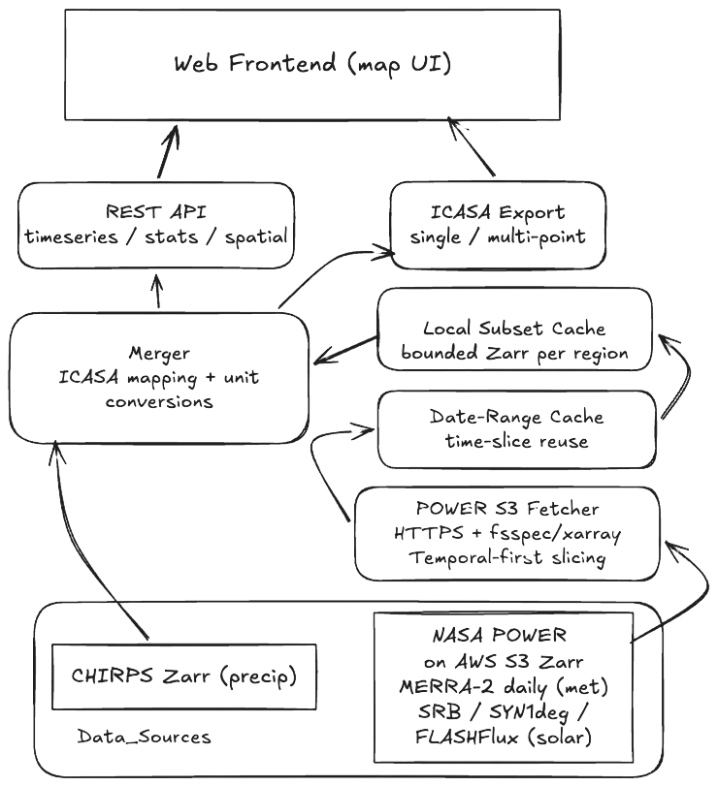
Results to Date (Real‑World Impact)
Speed: Batch ICASA export scales to large shapefiles with cache‑aware slicing (date‑range warm + local subset reuse)
Reliability: No rate‑limit concerns; consistent daily coverage; reproducible outputs for audits
Data courtesy of NASA POWER (https://power.larc.nasa.gov)

Slide 6
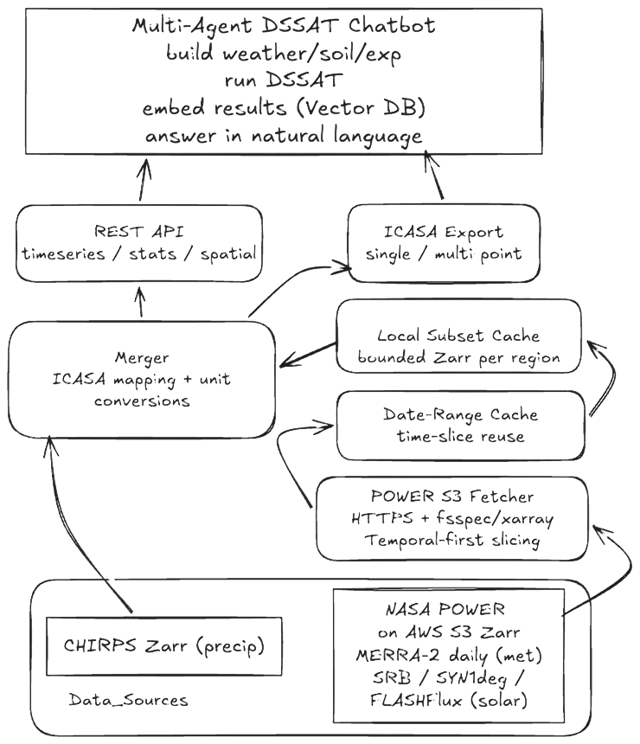
Results to Date (Real‑World Impact) cont.
Downstream: Multi‑agent DSSAT chatbot uses the same backend API to automate end‑to‑end essays: weather, soils, experiments, run DSSAT, embed outputs to a vector DB, and answer questions in natural language
Beneficiaries: Extension agents and local farmers gain pre‑season planning insight (planting windows, stress risk, irrigation need)
Data courtesy of NASA POWER (https://power.larc.nasa.gov)

Slide 7
Conclusions (Takeaways & Recommendations)
Key takeaway: NASA POWER on AWS Zarr is the enabler — performance, scale, and scientific integrity
Trade‑offs: Manage local cache lifecycle; accept 0.5° resolution; handle solar era transitions
Recommendation: Keep investing in analysis‑ready Zarr and clear variable/era metadata; it directly accelerates operational adoption
Thanks: Appreciation to the POWER team for open data, documentation, and S3 hosting
Data courtesy of NASA POWER (https://power.larc.nasa.gov)

Slide 8
Innovation & Future Vision
Desired POWER features: Stable cross‑era variable “crosswalks,” machine‑readable change logs, a public STAC/intake catalog, and lightweight update signals (webhooks) for new days
Emerging tech: AI agents orchestrating end‑to‑end modeling, anomaly QA on ingest, and RAG copilots grounded in POWER documentation and data
New opportunities: Pre‑computed ag indices (e.g., ETo/ETr), standardized uncertainty layers, and event‑driven pipelines for near‑real‑time advisories
Thank You
Data courtesy of NASA POWER (https://power.larc.nasa.gov)

